Slide 1




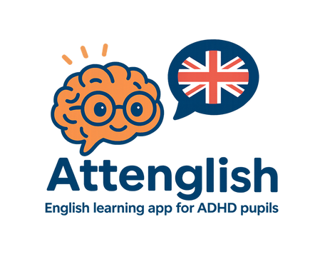

Attenglish: English Learning App for ADHD Pupils
Capstone Project 25-2-D-16
Presented by Kfir Amoyal & Omri Heit
Advisor: Dr. Natali Levi

Slide 2

Background
Attention-Deficit/Hyperactivity Disorder (ADHD) is increasingly prevalent in classrooms worldwide, posing significant challenges to both students and educators.
Learning English as a second or foreign language can be complicated for most lower-education pupils, but the process becomes particularly challenging for K-12 pupils diagnosed with ADHD or other learning difficulties.

Slide 3

The Need
While many existing language-learning platforms, such as Duolingo, Memrise etc., offer gamified lessons and interactive modules, few specifically address the unique challenges faced by ADHD students. From interviewing our stakeholder, Keren, her main “pain-points” are:
Multi‑level customization takes time.
Needs micro‑lessons & movement breaks.
Lack of AI powered lessons and exercises.
There are no real‑time “red buzzer” alerts & dashboards.
Wants
Needs

Slide 4





Present Day Solutions
Built-in accessibility
ADHD-aware browsers & timers
Specialized
Apps
Gamified
motivation
Classroom
Fundamentals

Slide 5

Introduction
Attenglish aims to enhance English learning experiences for students with ADHD. Our app focuses on engagement, adaptability and support, ensuring that every learner thrives in a fun and interactive environment tailored to their unique needs.

Slide 6
Enhancing Student Engagement
Our app integrates interactive elements to capture student interest and motivate learning, fostering a dynamic educational environment that encourages participation.
Project Objectives Overview
Adaptive Instruction Methods
Attenglish tailors learning experiences to the unique needs of each student, accommodating diverse learning styles and pacing for effective skill acquisition.
Involving Teachers and Parents
Regular updates for parents on student progress
Teacher resources for personalized instruction
Opportunities for collaborative feedback and improvements

Slide 7





Key Actors
Attenglish serves four key actors,
each having specific permissions:
Teacher
Monitors progress and provide support
Student
Engages with tailored content
Parent
Tracks their child's development
Admin
Ensures smooth operation and management of the platform

Slide 8





Functional and Non-Functional Requirements
Engagement
Adaptability
Parental Involvement
Measurable Outcomes
Security
Promote active learning and participation
Tailored experiences for diverse learners
Facilitating communication with parents
Assessing student progress effectively
Protecting user data and privacy
Attenglish adapts to individual learning styles and paces for enhanced understanding.
Regular assessments provide quantifiable results to track student improvements.
Attenglish ensures the highest security standards for user data protection.
The app encourages student engagement through interactive activities and feedback.
The app offers features that promote collaboration between parents and educators.
* The requirements were given by our stakeholder, Keren Yerushalmi, a middle-school English teacher.

Slide 9







Our Technology Stack
The Attenglish app utilizes cutting-edge technologies to
ensure optimal performance:
Cross-Platform
Development
Content & Analytics Generation
Database
Backend
Frontend
Flutter
Firebase
Node.js
React.js
OpenAI

Slide 10
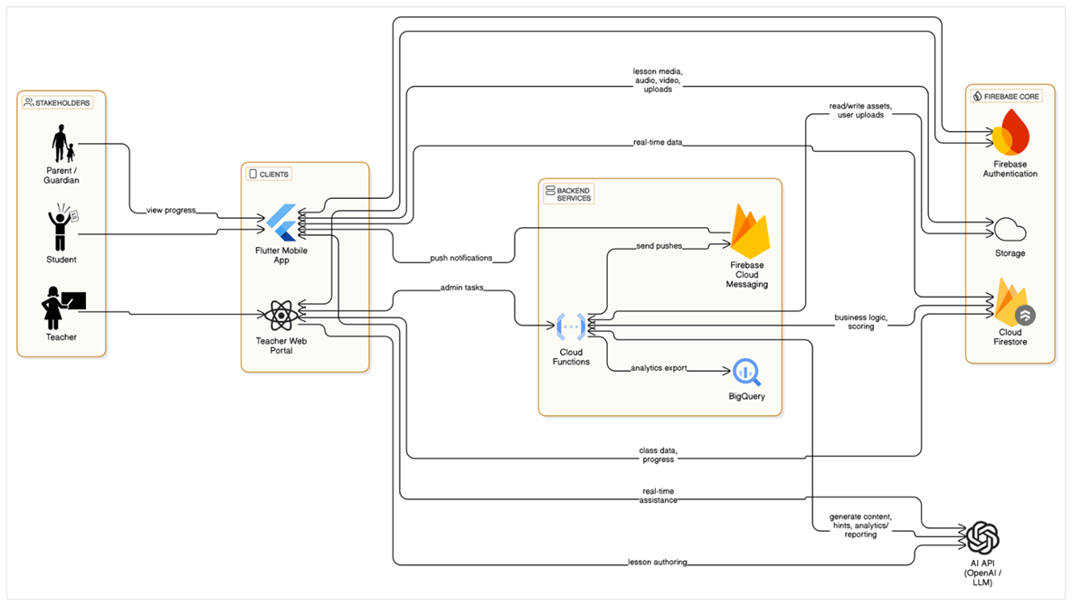
System Architecture Overview
The Attenglish architecture supports seamless communication between the client and backend. Our system includes three main components: the client app, backend services, and a robust database, ensuring efficient data handling and user experience.

Slide 11
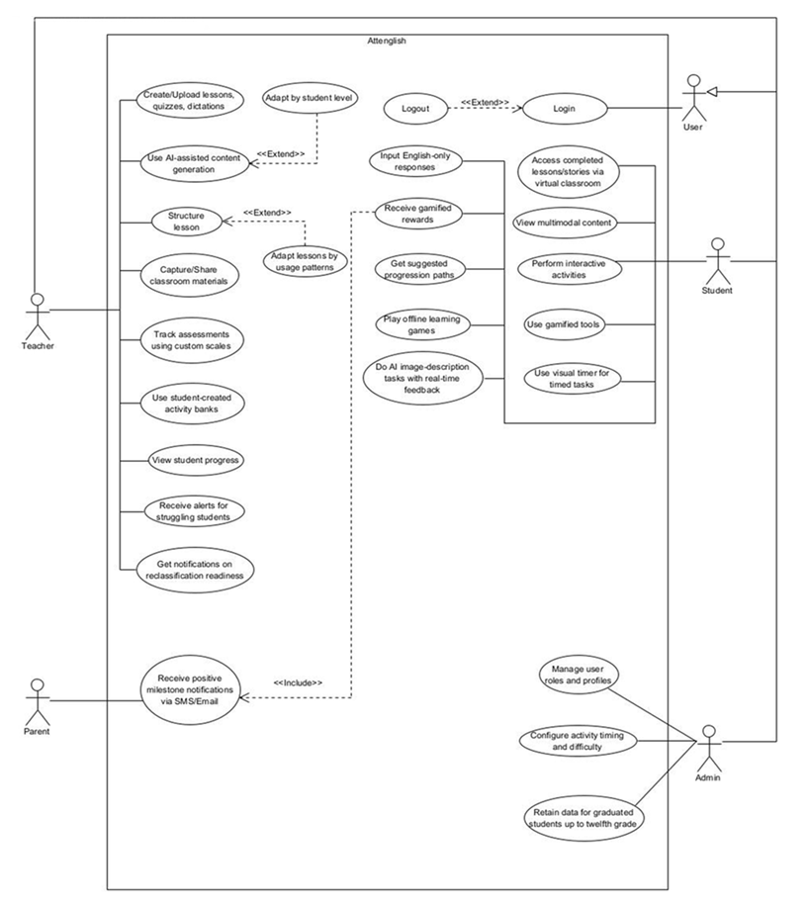

Use Case Diagram Overview

Slide 12
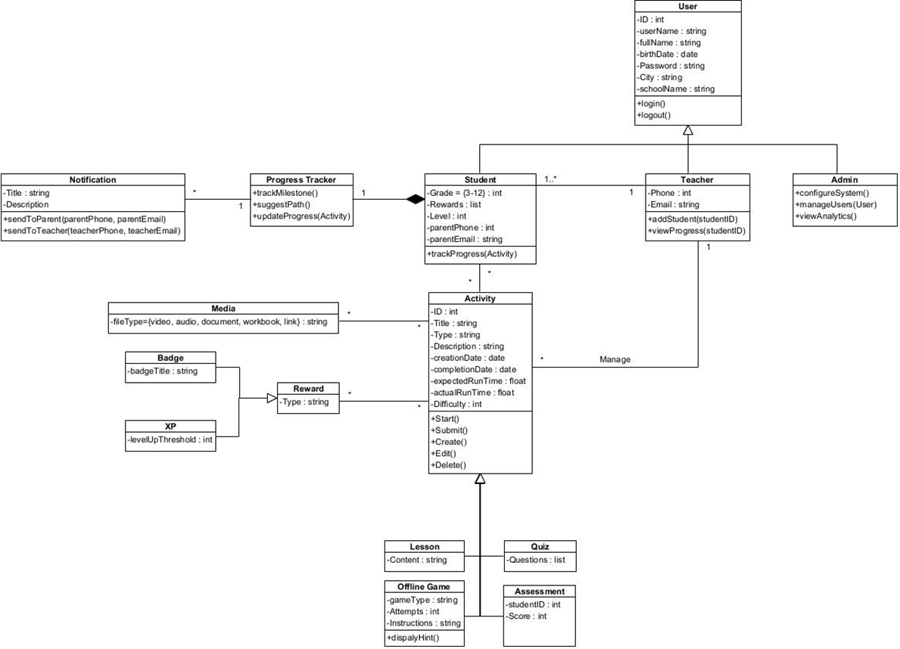

Class Diagram Overview

Slide 13

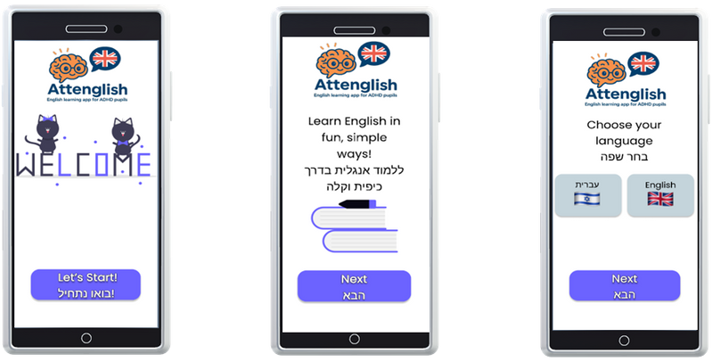
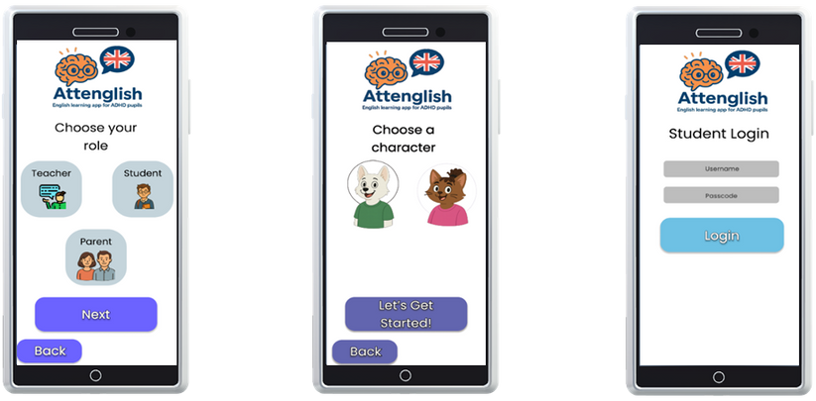
Front-End UI Concept
The Attenglish app interface is designed with ADHD learners in mind. Features include intuitive navigation, engaging visuals, and interactive elements to enhance focus and encourage active participation, promoting a playful learning experience tailored for young minds.

Slide 14




Challenges and Solutions
The development of Attenglish faces multiple constraints and challenges.
These include but not limited to:
User Constraints
All of our users vary in technical proficiency and device familiarity
Time Constraints
Our development window spans only a few months, making timely delivery of every milestone essential
Technical Constraints
Guaranteeing seamless operation across a range of devices and operating systems demands extensive compatibility testing and fine-tuning
Integrated Constraint Management
We address all our constraints through a coordinated strategy. This structured path - from discovery through specification, prototyping, and iterative validation - ensures that Attenglish addresses real educational pain points while meeting tight budgetary, security and timeline constraints
Notes:
In this slide, we talk about the main challenges we will face while developing Attenglish.
First, we have User Constraints. Our users — pupils, teachers, and parents — all have different levels of tech knowledge and use different devices, so the app must be extremely simple and easy to use.
Then we have Time Constraints. We only have a few months to build everything, so we must stay focused and make sure we deliver each part on time.
And of course, Technical Constraints. Since we want the app to work smoothly on many devices and systems, we must do a lot of testing and fine-tuning.
To deal with all these, we intend to use a clear, structured Agile approach — from planning, to building, to testing. This will help us stay on track and build a real solution for ADHD pupils, without losing time or quality.

Slide 15
Evaluation and Testing Milestones
Actor | Core Use-Cases to Validate | Desirable Test Outcomes | Primary Test Layer(s)
Student | • Login / Logout • Access completed lessons/stories (virtual classroom) • View multimodal content • Perform interactive activities • Use visual timer for timed tasks • Input English-only responses • Play offline learning games • Do AI image-description tasks with real-time feedback • Use gamified tools & receive rewards • Get suggested progression paths | 1. Path flow: Login → open classroom → start timed activity → complete with English-only input → receive reward → suggested next task appears. 2. Offline mode: start a cached “learning game”, finish, reconnect, verify progress sync. 3. AI vision: upload image, receive description hints in < 1 s; profanity filter blocks inappropriate content. | Flutter widget tests → Firebase Emulator E2E → Manual functional & UX
Teacher | • Login / Logout • Create / upload lessons, quizzes, dictations • Structure lesson (and extend “Adapt by student level / usage patterns”) • Capture / share classroom materials • Track assessments on custom scales • Use student-created activity banks • View student progress dashboards • Receive alerts for struggling students • Get notifications on reclassification readiness | 1. Authoring: drag-drop PDF → AI content generator suggests 10 quiz items → teacher edits, saves lesson; lesson visible to assigned class. 2. Adaptive tweak: flag student as “needs shorter timer”; verify lesson copy auto-inherits new timer. 3. Alerting: student fails 3 consecutive tasks → Cloud Function sends teacher push & portal badge. | React component tests → Cypress E2E → Manual functional
Parent / Guardian | • Receive positive milestone notifications via SMS / Email | 1. Pupil achieves 5-day streak → Twilio SMS sent; verify correct phone masked in logs. | Cloud-Functions unit tests → Postman mock-callback
Admin | • Manage user roles & profiles • Configure activity timing & difficulty • Retain data for graduated students up to 12th grade | 1. Bulk CSV import → 100 users created with correct roles. 2. Change default timer from 45 → 30 s; confirm new lesson picks. 3. Archive graduated class; verify records are still queryable (read-only) after 30 days. | Jest unit → Admin-portal Cypress → Data-retention integration tests

Slide 16
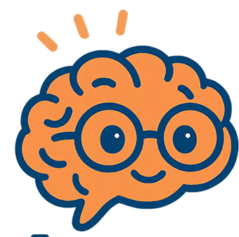


Thank you!
Any questions?

